Slide 1

RECOMMENDATION OF WEBSITES BASED ON REVIEWS
Group- 14
AMANDEEP KAUR

Slide 2
Table of content
Description
Data COLLECTION
Scrapy AND IMPORT.IO
Challenges
Ethical principles
Outcome assessed
references
DATA CLEANING /FINAL DATA
METHODOLOGY
DATA EXPLORATION

Slide 3
Description
Most of the customer rely on reviews to make any decision related to purchases or any service utilization provided.
We would like to address the project by classifying the reviews into most preferable and least preferable based on purchased and non-purchased respectively.
Our focus is to concentrate mainly on purchased user reviews for this project. Finally, recommend the website based on genuine reviews.

Slide 4
Ethical principles
Consent:
This project, Recommendation of Websites based on review is chosen to give the genuine information to the customers. To implement this project, data is collected from e-commerce websites were the user’s opinions are given for the products/services with consent. Here we are using the data which is openly available for the better product and website recommendation.
Clarity:
This dataset provides information regarding product details, reviews, rating, purchase date, product URL. Review URL etc. with which we can analyze the data and build appropriate models for efficient recommendation engine.

Slide 5
Ethical principles
Consequences:
In our dataset we are not retrieving any personal information of customers so there are no consequences to be deal with.
Control and Transparency:
We have merged the data collected from various ecommerce site and formed a dataset. Here the information is analyzed using sentimental analysis to filter out the classification and perform further process we assure that the data will not be manipulated or mis-used.
Consistency:
Our data is consistent as we are interpreting the intentions of customers through the reviews and analyzing their views on the product to build better recommendation model for search engine. As our dataset does not contain any personal information about the users so, we are consistent with the information taken from online sites to work on our project.

Slide 6
Dataset Collection
Overview: we have collected 28887 rows with 16 attributes from online sources and using scrapy /import.io tools.
Product name
Categories
Primary Categories
Image URLs
Manufacturer
Reviews Source URLs
Review title
Attributes
The websites: BestBuy, Amazon,Redsky, Newegg

Slide 7

Scrapy Import.io
Scrapy provides a powerful framework for extracting the data, processing it and then save it. It is based on SPIDERS to extract the information from any websites.
However, Import.io extract the data in table format from a webpage. Which you can save further.

Slide 8
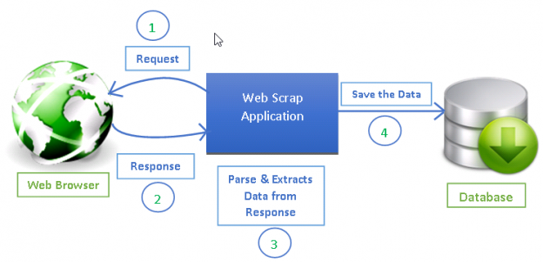
Crawling of webpage

Slide 9
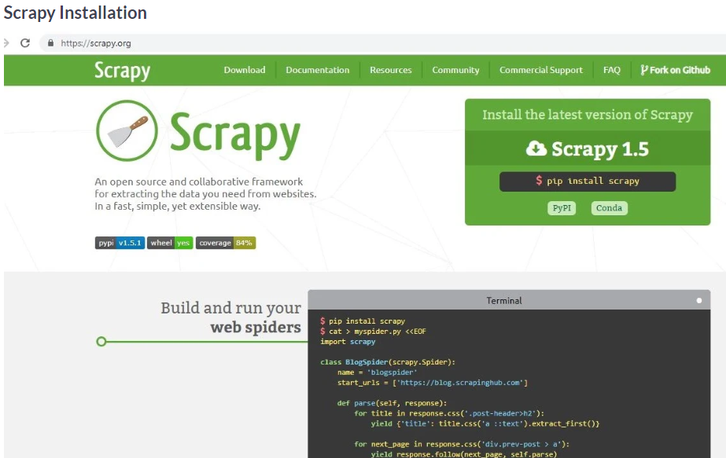

Slide 10
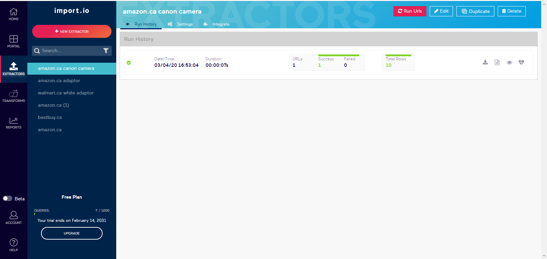

Slide 11
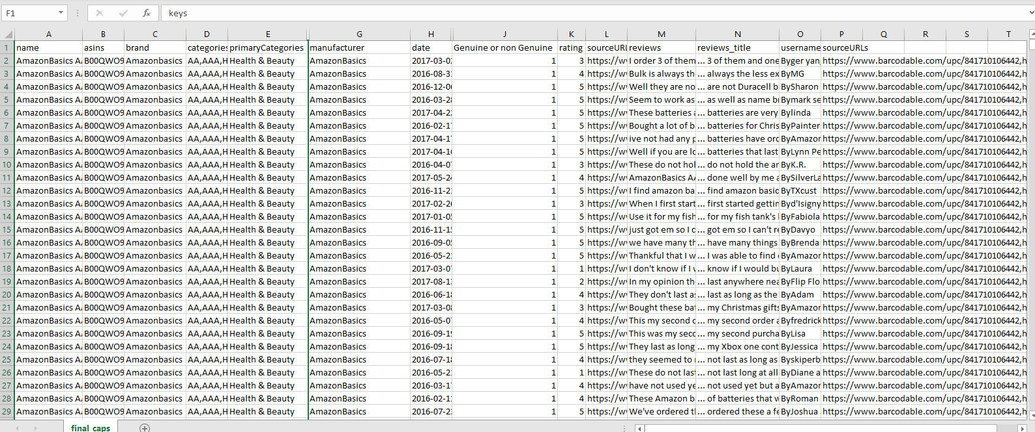

Slide 12
Challenges
Collecting data itself a challenge
Scrapy is a project itself
Merging of different datasets
USING FAKESPOT FOR INDIVIDUAL LINK OF REVIEWS

Slide 13
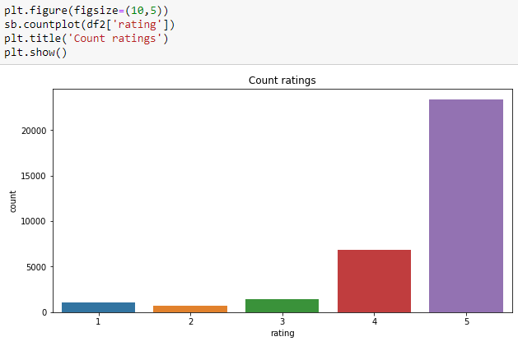
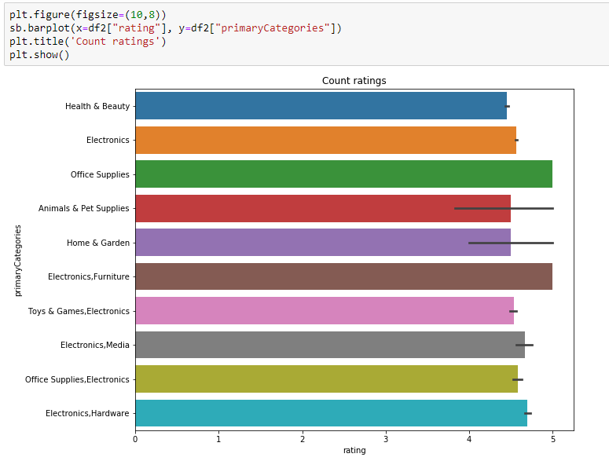
Data Exploration
It is evident from the graphs that the reviews are heavily biased towards positive reviews. 4 and 5 ratings are extremely high and the average of the ratings are above 3. Whereas the categories wise the highest rating is of electronical objects. However, others are also good enough.

Slide 14
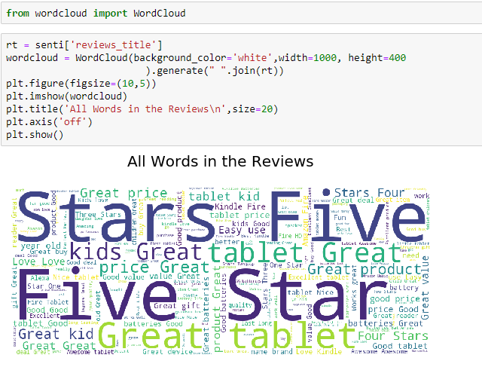
Data Exploration
This is word count of all the words which are in the reviews. It seems that most of the words are positive.

Slide 15
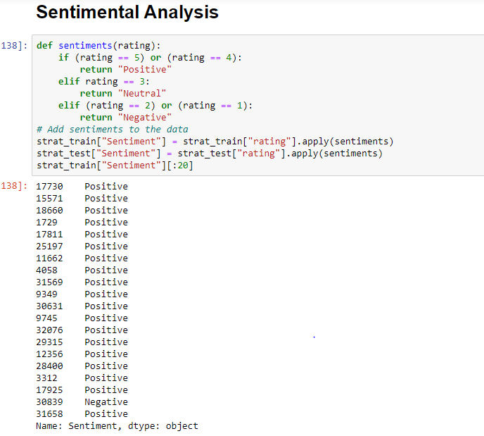
Methodology

Slide 16
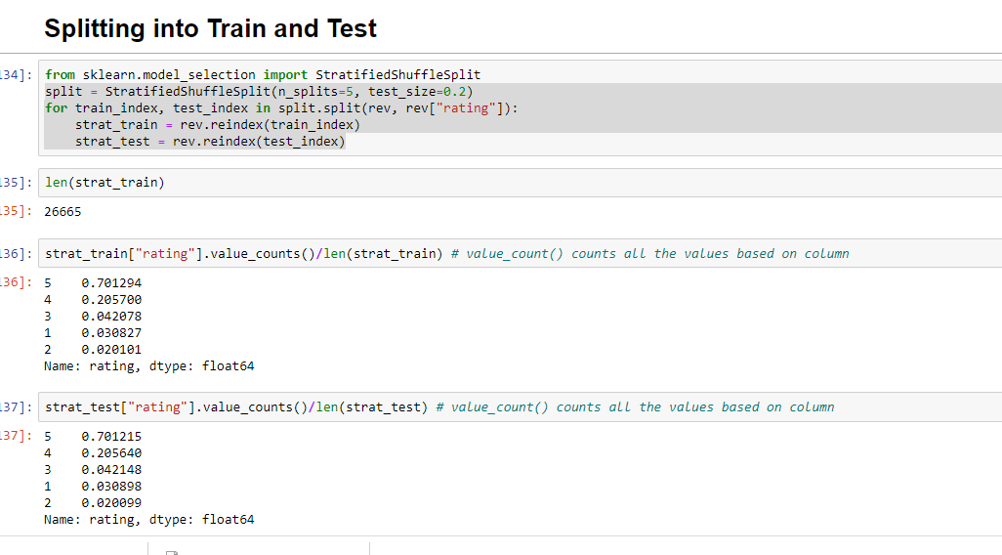
Methodology

Slide 17
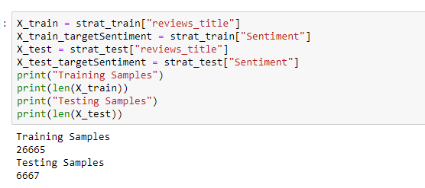
Methodology

Slide 18
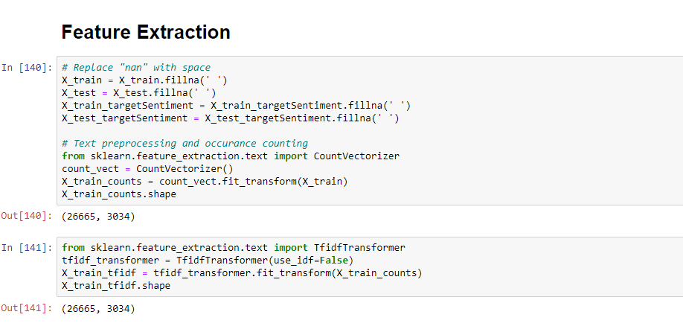
Methodology

Slide 19
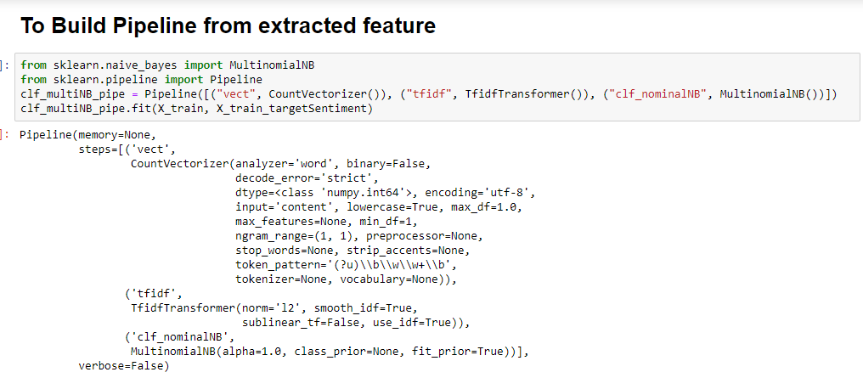
Methodology

Slide 20
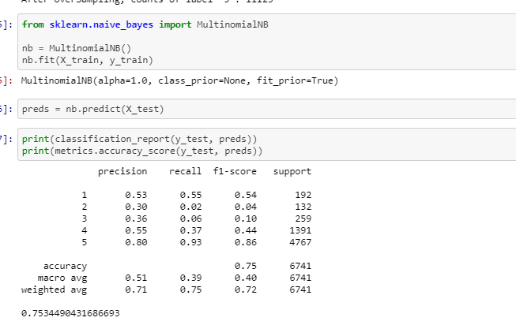
Methodology

Slide 21
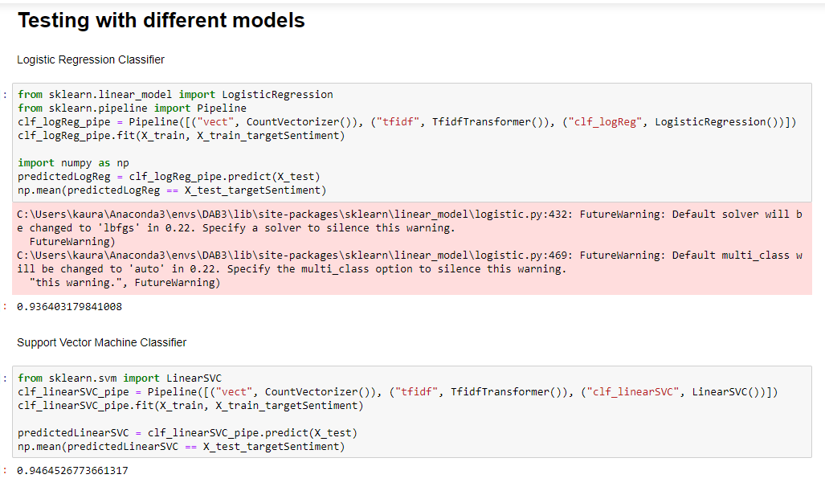
Methodology

Slide 22
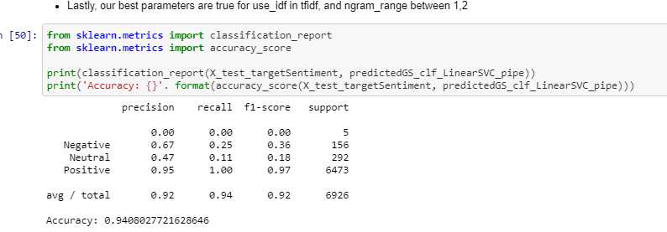
Methodology

Slide 23
Outcomes Assessed
Sentimental analysis will be done to get the categories of reviews. The categorization of the reviews by using any classifier we can get most preferable and least preferable.
In the analysis we will filter out the reviews of non-buyers of any product to give genuine information written by customers as a result of search engine.
Final results, the websites having more positive reviews are recommendable. As of the classification report of all the models which tells us the categorization of positive, negative and neural reviews.

Slide 24
Reference DataCamp Community. (2020). Making Web Crawlers Using Scrapy for Python. [online] Available at: https://www.datacamp.com/community/tutorials/making-web-crawlers-scrapy-python#overview. Tableau + ParseHub Integration: Use Tableau to Visualize Data Scraped by ParseHub. (2020). From https://www.parsehub.com/blog/use-tableau-to-visualize-data-scraped-by-parsehub/ Ganesan, K. (2020). User Review Datasets | Kavita Ganesan. From https://kavita-ganesan.com/user-review-datasets/#.Xkv3sChKhPY (2020). Retrieved 10 April 2020, from https://app.import.io/dash/extractors/174ddd6c-2a6b-4126-b182-7c15968edb67/history

Slide 25

Thank you

